Slide 1
Scrum Overview
Agile Principles and Practices Applications

Slide 2
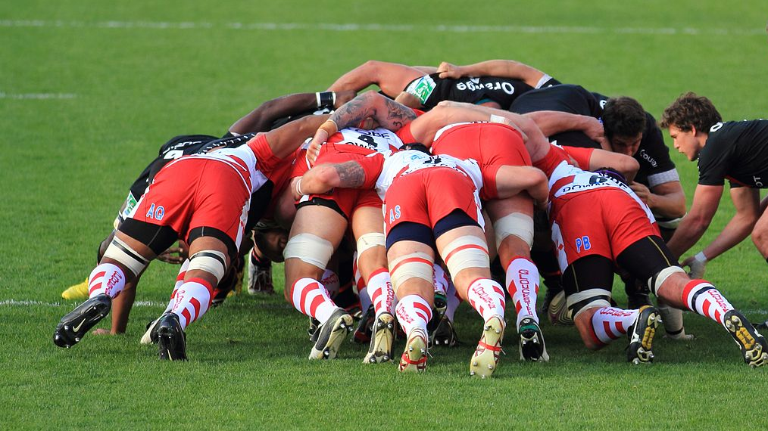
Metaphor
A scrum (short for scrummage) is a method of restarting play in rugby that involves players packing closely together with their heads down and attempting to gain possession of the ball.

Slide 3
Scrum In Software Products Development
Scrum’s rich history can be traced back to a 1986 Harvard Business Review article, “The New New Product Development Game” by Takeuchi and Nonaka in 1986.
In 1993, Jeff Sutherland and his team at Easel Corporation created the Scrum process for use on a software development effort by combining concepts from the 1986 article with concepts from object-oriented development, empirical process control, iterative and incremental development, software process and productivity research, and complex adaptive systems.
In 1995, Ken Schwaber published the first paper on Scrum at OOPSLA 1995

Slide 4
Scrum Guide (2013)
«Scrum is a framework for developing and sustaining complex products. This Guide contains the definition of Scrum. This definition consists of Scrum’s roles, events, artifacts, and the rules that bind them together. Ken Schwaber and Jeff Sutherland developed Scrum; the Scrum Guide is written and provided by them. Together, they stand behind the Scrum Guide.» – from the Guide

Slide 5
Genomica Experience
Measure | Waterfall | Scrum
Effort | 10x | 1x
Velocity | 1x | 7x
Customer satisfaction | Poor | Excellent

Slide 6
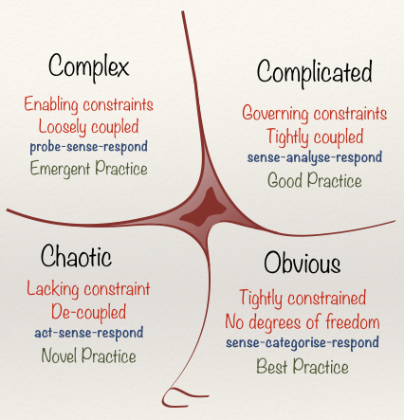
Cynefin Framework
Scrum is particularly well suited for operating in a complex domain. In such situations our ability to probe (explore), sense (inspect), and respond (adapt) is critical.
Scrum is not well suited to highly interrupt-driven work.

Slide 7
Scrum Roles
Product Owner
ScrumMaster
Development Team

Slide 8
Product Owner
The product owner is the empowered central point of product leadership.
The product owner is the single authority responsible for deciding which features and functionality to build and the order in which to build them.
The product owner maintains and communicates to all other participants a clear vision of what the Scrum team is trying to achieve.

Slide 9
ScrumMaster
The ScrumMaster helps everyone involved understand and embrace the Scrum values, principles, and practices.
The ScrumMaster is also responsible for protecting the team from outside interference and takes a leadership role in removing impediments that inhibit team productivity (when the individuals themselves cannot reasonably resolve them).
The ScrumMaster has no authority to exert control over the team, so this role is not the same as the traditional role of project manager or development manager.

Slide 10
Development Team
The development team self-organizes to determine the best way to accomplish the goal set out by the product owner.
The development team is typically five to nine people in size; its members must collectively have all of the skills needed to produce good-quality, working software.
Fewer than three development team members decrease interaction and results in smaller productivity gains.

Slide 11
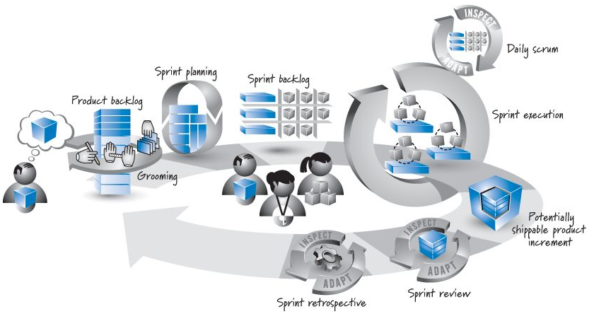
Scrum Framework

Slide 12
Product Backlog
Product backlog is a prioritized inventory of ongoing product backlog items
Product backlog item is an item such as a feature, defect, or technical work that is valuable from the product owner’s perspective
Overall the activity of creating and refining product backlog items, estimating them, and prioritizing them is known as grooming

Slide 13
Sprints
In Scrum, work is performed in iterations or cycles of up to a calendar month called sprints
Sprints are timeboxed so they always have a fixed start and end date, and generally they should all be of the same duration

Slide 14
Sprint Planning
To determine the most important subset of product backlog items to build in the next sprint, the product owner, development team, and ScrumMaster perform sprint planning
During sprint planning, the product owner and development team agree on a sprint goal that defines what the upcoming sprint is supposed to achieve
Development teams break down each targeted feature into a set of tasks – sprint backlog
Development team provides an estimate (typically in hours) of the effort required to complete each task

Slide 15
Daily Scrum
Daily scrum (aka daily stand-up) is a short timeboxed (up to 15 min) activity to synchronize on team progress and promptly discover any impediments
Each team member answers these questions:
What did I accomplish since the last daily scrum?
What do I plan to work on by the next daily scrum?
What are the obstacles or impediments that are preventing me from making progress?
+ two questions suggested by C. Larman (and approved by Sutherland and Schwaber):
Any tasks to add to the Sprint Backlog? (missed tasks, not new requirements)
Have you learned or decided anything new, of relevance to some of the team members? (technical, requirements, ...)

Slide 16
Sprint Results
Sprint results in potentially shippable product increment
“potentially shippable” does not mean that what got built must actually be shipped
Sprint results are evaluated according to agreed definition of done
At the end of the sprint there are two additional inspect-and-adapt activities: sprint review and sprint retrospective
The goal of sprint review is to inspect and adapt the product that is being built
Whereas the sprint review is a time to inspect and adapt the product, the sprint retrospective is an opportunity to inspect and adapt the process

Slide 17
Common mistakes & misunderstandings
Not a self-directed team; managers or ScrumMaster direct or organize the team
No daily update of the sprint backlog
New work added to iteration
Product owner isn't involved or doesn't decide
No sprint review
Scrum Meeting too long or unfocused
Each iteration ends in a production release
Iteration doesn't end in an integrated and tested partial product

